Slide 1

genesis.re
operating system for the new world
architecting a new planet

Slide 2


Slide 3


Slide 4


Slide 5

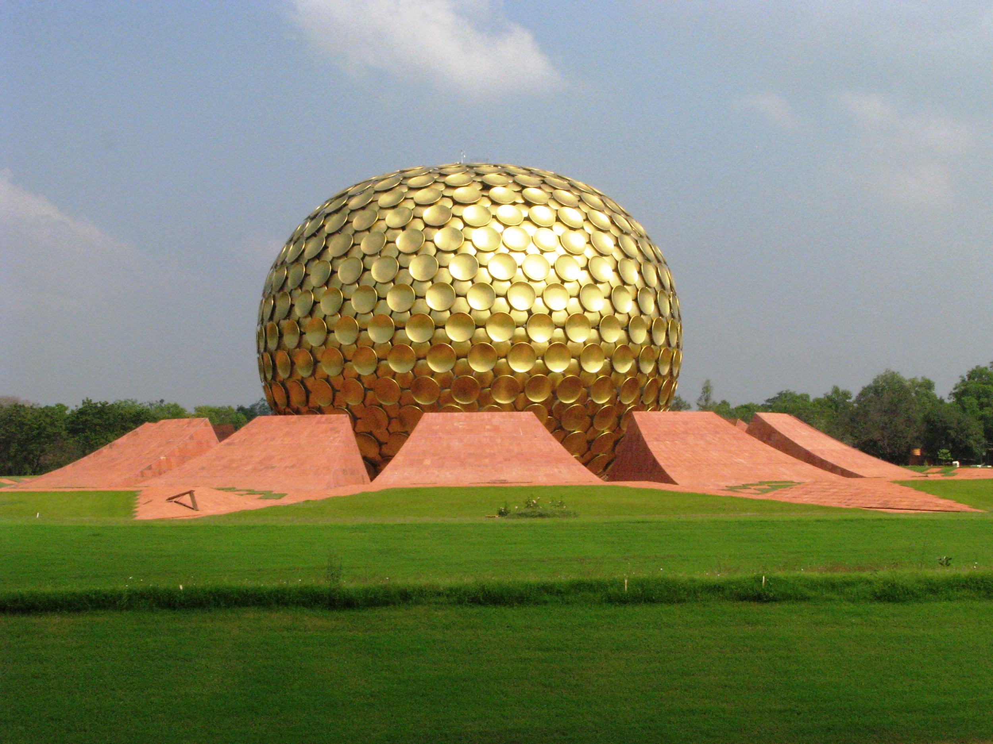
Tamera is a peace research village.
https://en.wikipedia.org/wiki/Tamera
The purpose of Auroville is to realize human unity.
https://en.wikipedia.org/wiki/Auroville

Slide 6
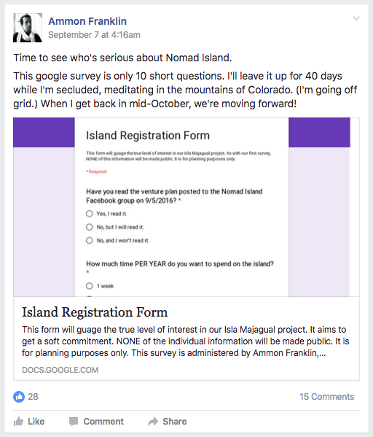


Slide 7
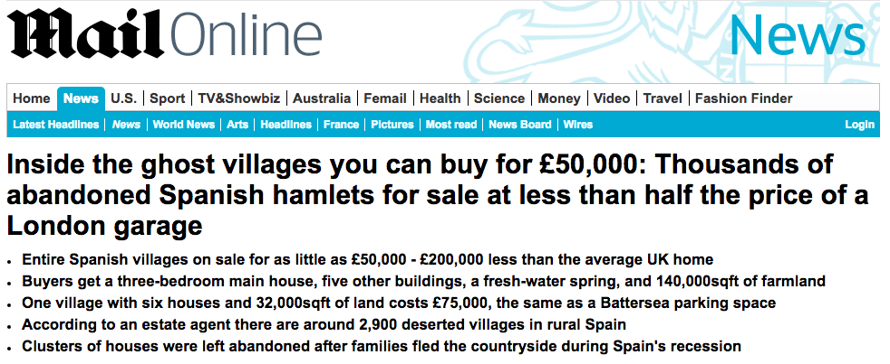

Slide 8
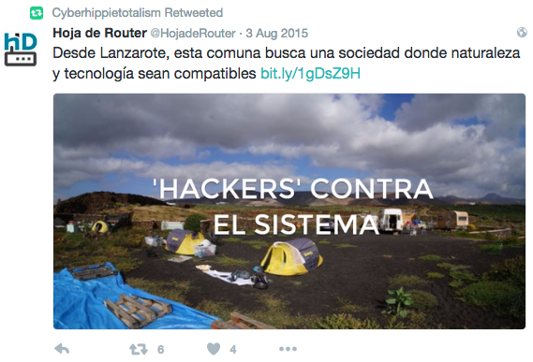
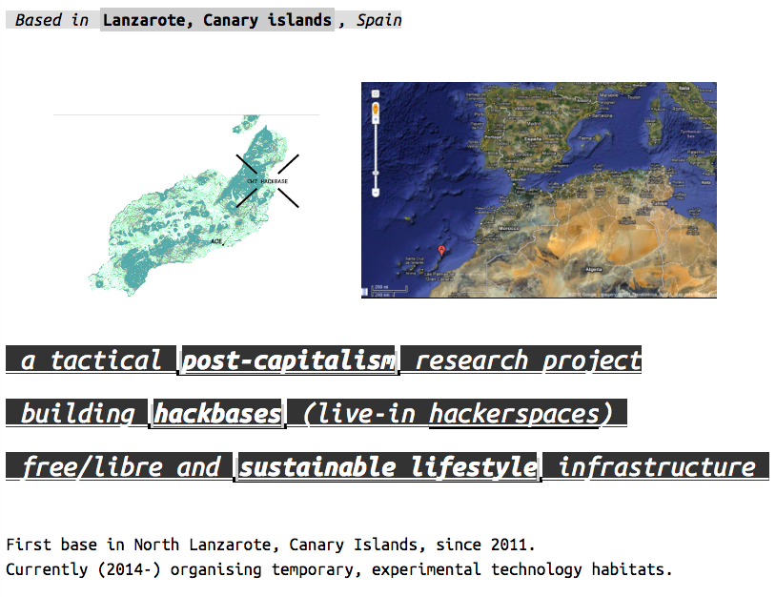
@chtotalism

Slide 9
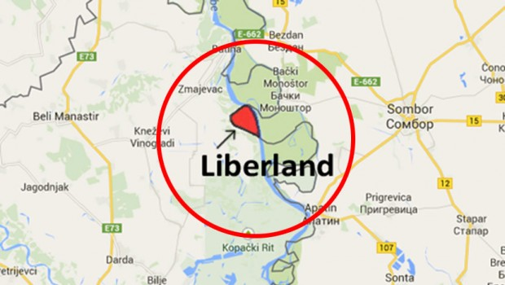
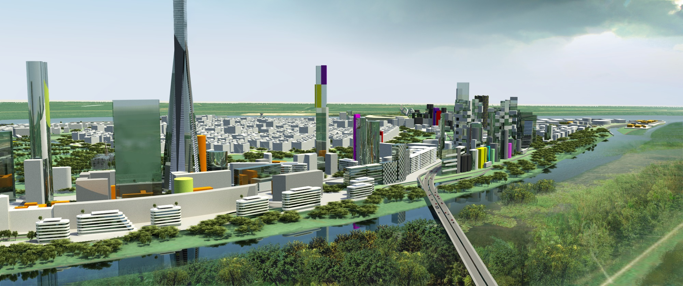

Slide 10
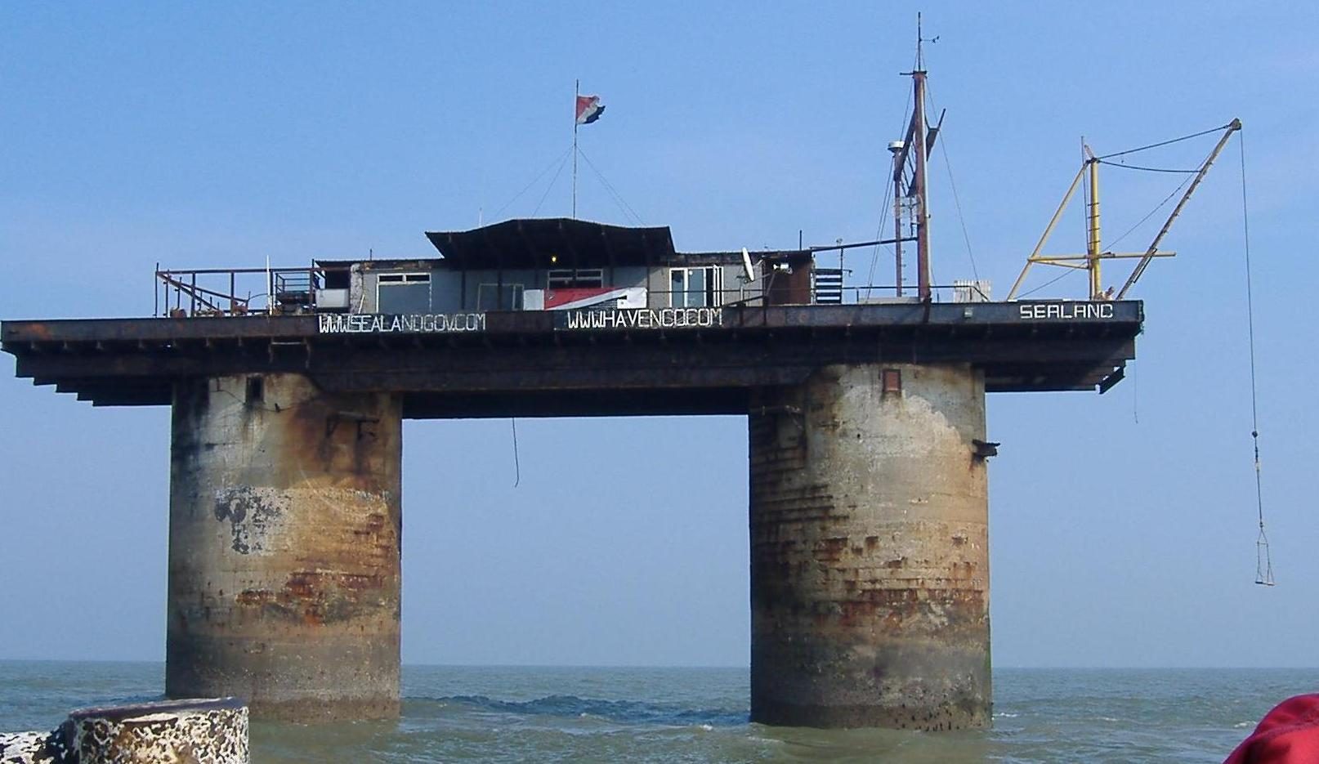

Slide 11


Slide 12
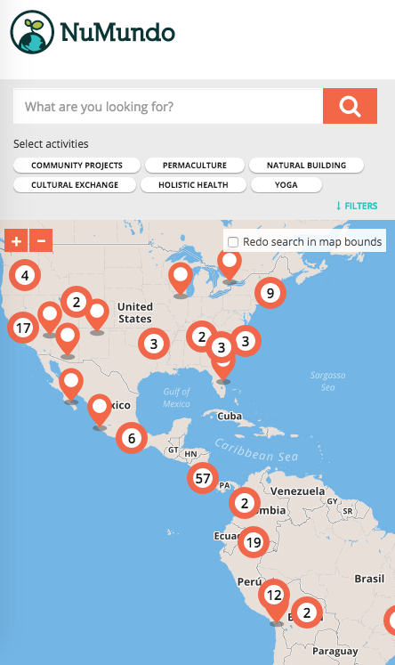
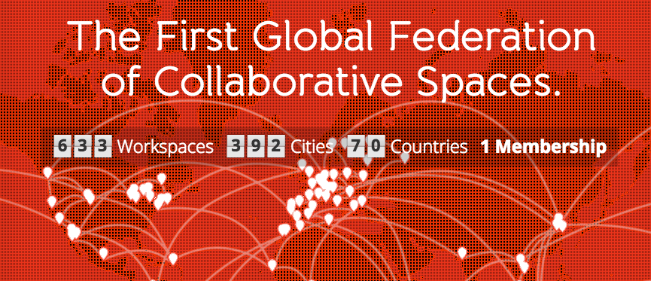
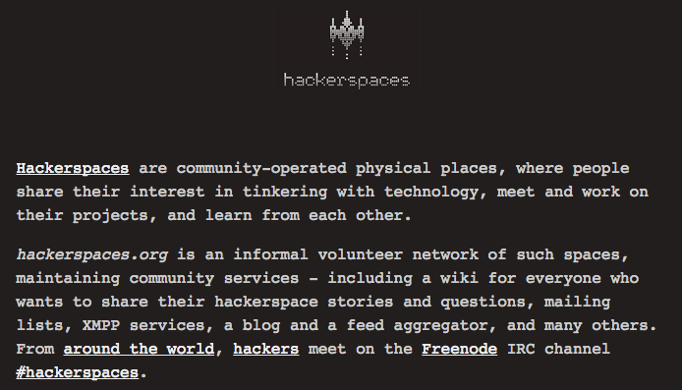

Slide 13
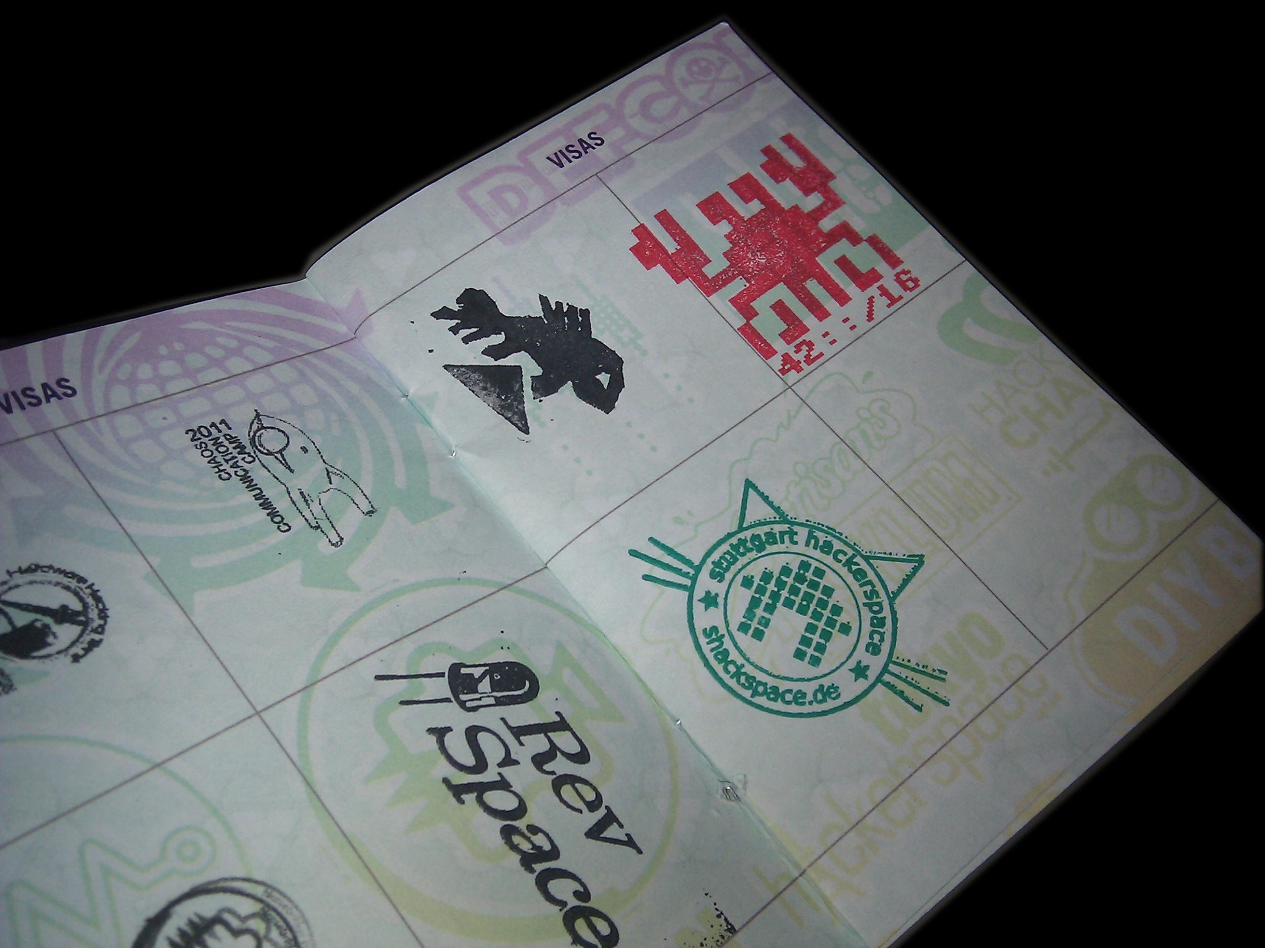


Slide 14
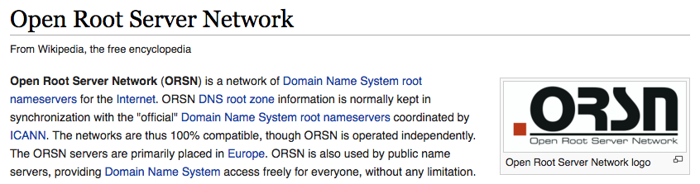
Alternative to ICANN

Slide 15
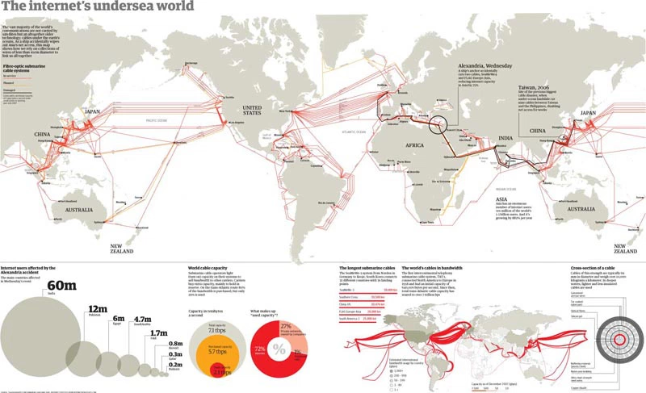

Slide 16
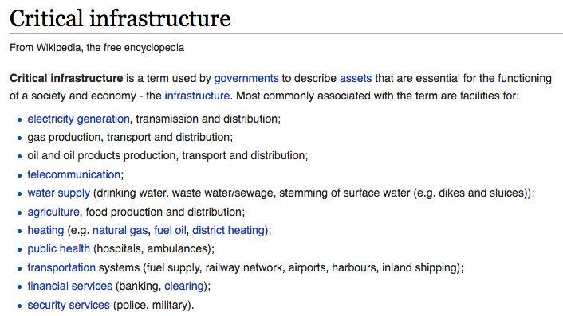

Slide 17
genesis.re
learning how to live Earth
before spreading to outer space
operating system for the new world
architecting a new planet

